Slide 1

Wadak.com
2nd year group project
SCS2202
Supervisor : Ms. S. Thrimahavithana
Co-supervisor: Mr. Akila Gamage

Slide 2
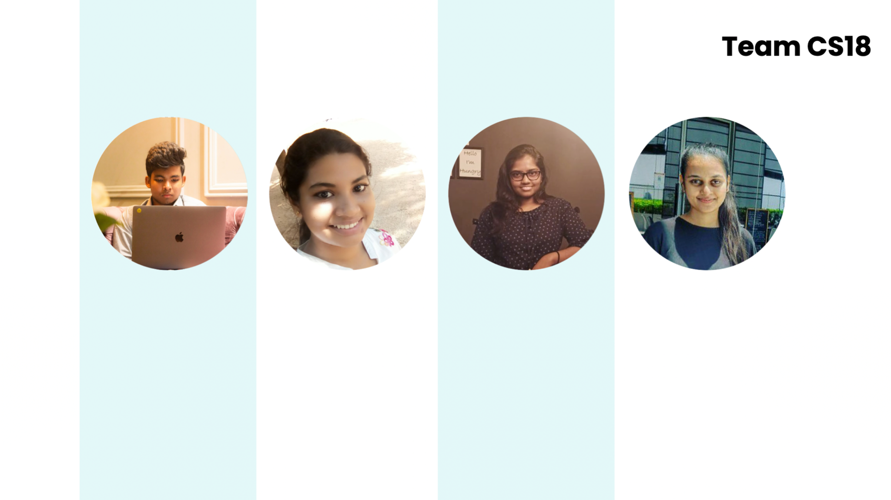
Team CS18
H L Harith Iduwara
V D L Wathsala
S S Malsha
D G Hansika Kumari
2019/CS/060
2019/CS/180
2019/CS/090
2019/CS/074

Slide 3

Introduction
We are a group of Undergraduates of University of Colombo School of Computing. We have got a task to get completed. We have seen the need of a platform like this to the IT industry. So did research about IT B2B platforms. After we came up with this amazing idea .
WADAK.com

Slide 4

Table of content
01. Problem Definition
02. Requirement Analysis
03. Feasibility Study
04. Limitations & Constraints
05. Technologies
06. Workload Distribution

Slide 5


PROBLEM DEFINITION
Hardness to find quality IT service providers
Huge amount of commissions rates and high fees.
Pandemic situation.
Talented IT service providers?
Genuine Customers?

Slide 6

Did you ever required to find a IT service provider to complete any type of IT related task with pocket money and in a little time ?
BLA BLA BLA

Slide 7
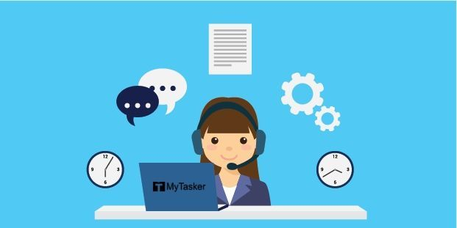
HIRE
PERSON
A service provider with excellent abilities, knowledge, and a proven portfolio.
Compare previous work of each service provider in one place.
Spending high fees and high commission rates.
Spending time to find a IT service provider.

Slide 8

SERVICE
PROVIDER
Finding job provider.
Getting payments without paying fees or commission.
Free marketplace

Slide 9
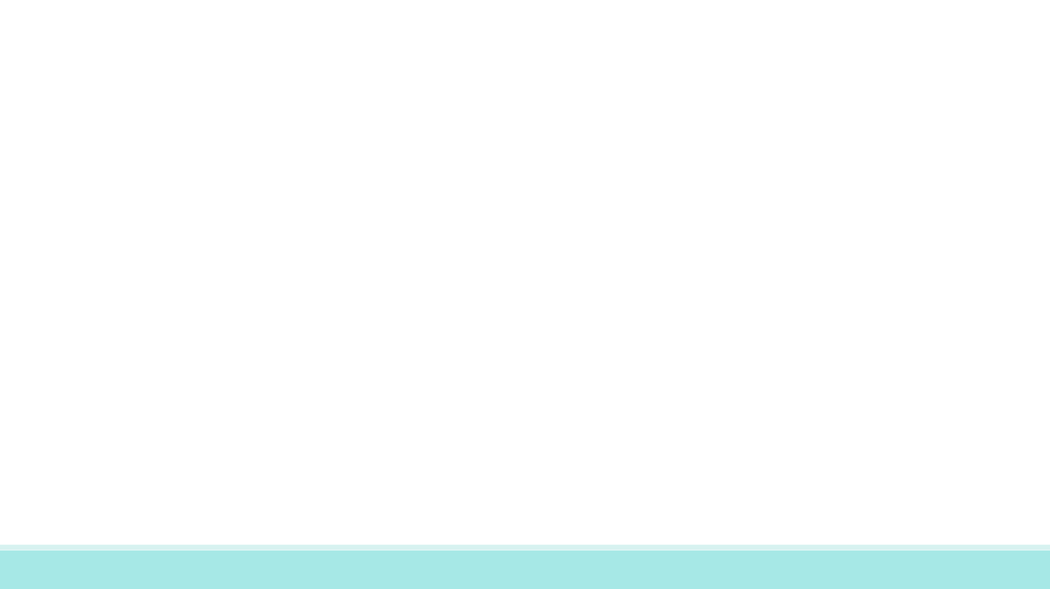
COMPETITOR ANALYSIS
 | Fiverr | Upwork | Our system (WADAK)
Predefined task and prices | Yes | No | Yes
Easy to find service providers by searching | Yes | No | Yes
Completion fees | Yes | Yes | No
Membership | No | Yes | No

Slide 10

PROJECT GOAL
To produce a fully functioning, user friendly web based system for IT workers and for Hire persons, to find jobs and to ones who wants to get IT works done. solve the current problems in online platforms, maximize the efficiency of the online platform by saving the customers money and time.

Slide 11


PROJECT
SCOPE…...

Slide 12
In-SCOPE
Only a web application will be made.
The functionality will be limited to,
Contacting the service provider, rating, reviewing, and reporting functionalities for the hire person.
Contact the hire persons for the service provider.
Manage co-admins, service providers, and Hire person, manage website, report generation for the Admin.
Manage service providers and hire persons, handle the advertisements through the system, manage Q&A sessions for co-admin
The system should provide filtering criteria when searching service providers or job posts.
A sandbox will be used for the online payment model (for advertisements).

Slide 13
Out-SCOPE
There is no function that automates the payment units through the system such as doing payments for the service provider through the system.

Slide 14





User Identification
Admin
Co-Admin
Hire Person
Service Provider

Slide 15

Requirement
Analysis...

Slide 16

Functional
Requirements...

Slide 17

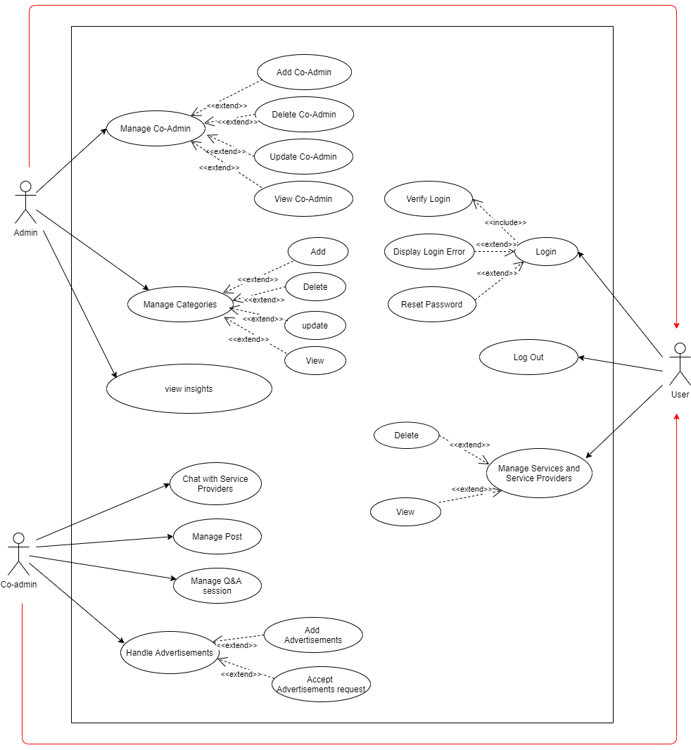
Use Case Diagram

Slide 18

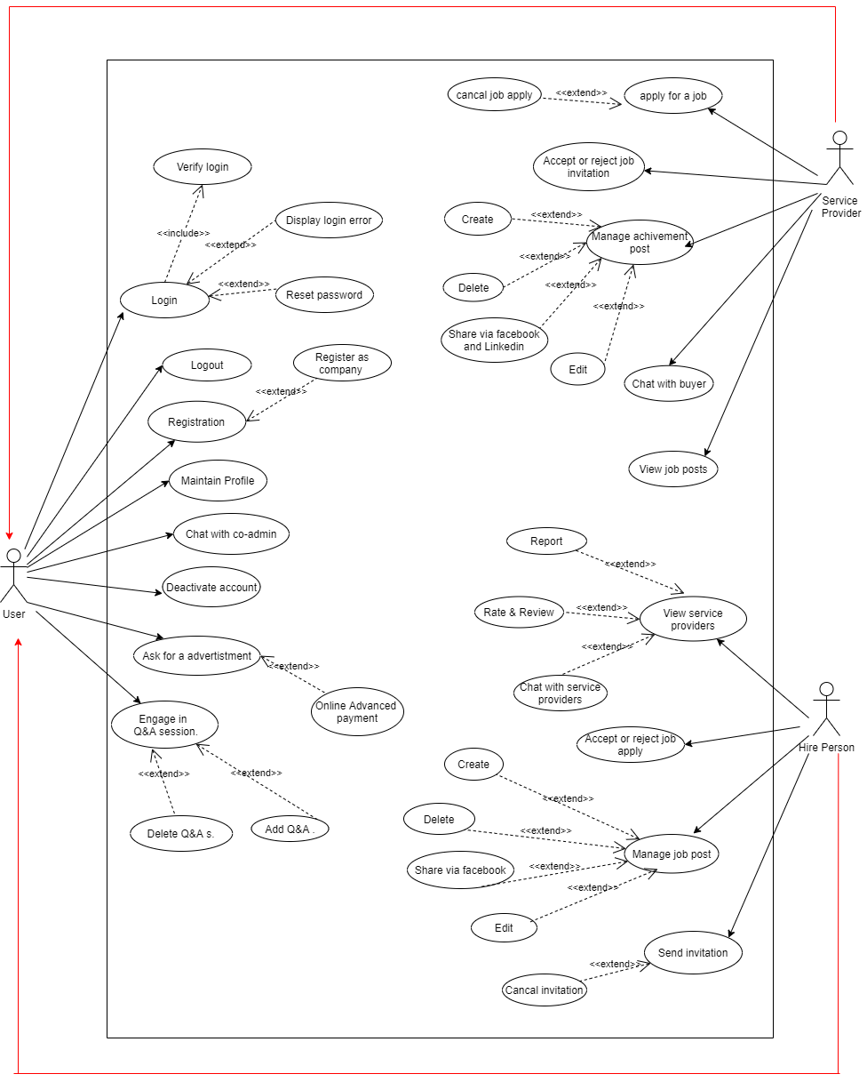
Use Case Diagram

Slide 19
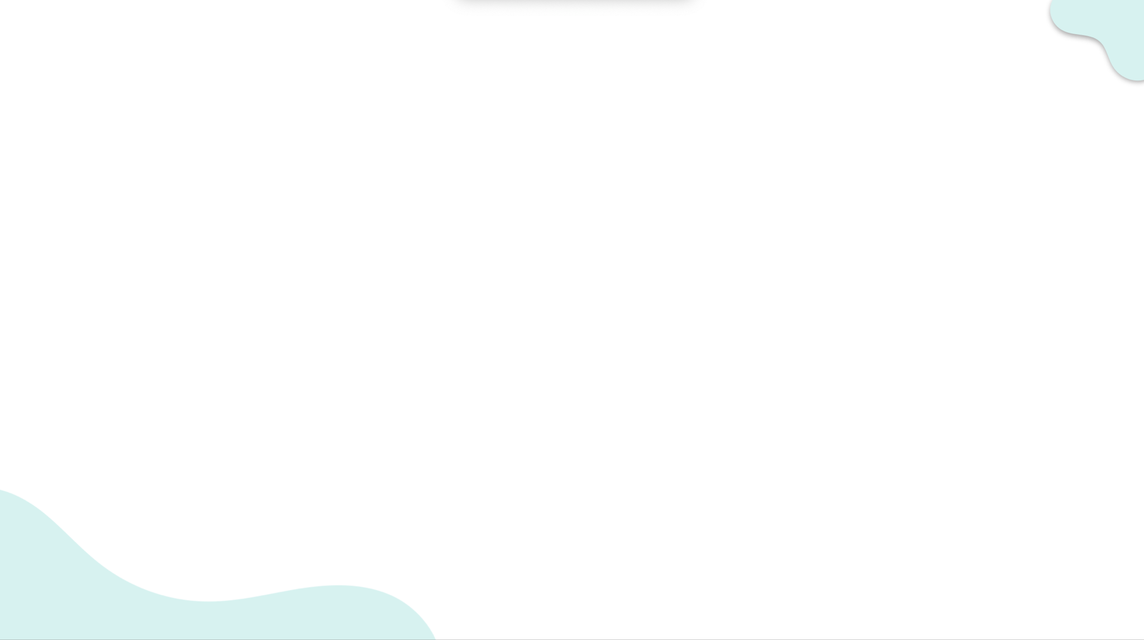
ADMIN
Manage co-admins
Manage hire persons & service providers
Manage service Categories
View reports of the view insights

Slide 20
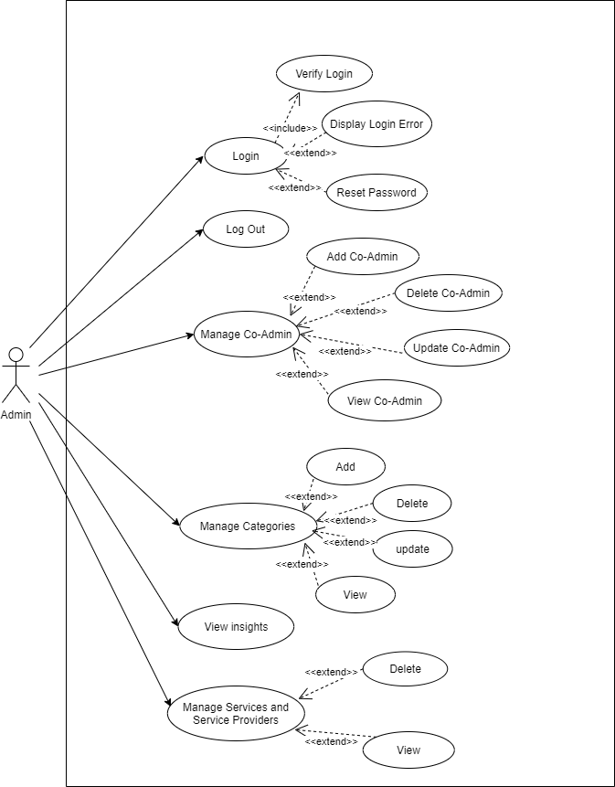
ADMIN

Slide 21
CO-ADMIN
Manage hire persons & service providers
Handle the chat with hire persons & service providers
Manage posts
Manage Q&A sessions
Handle Advertisements
Accept advertisement requests and Add advertisements

Slide 22
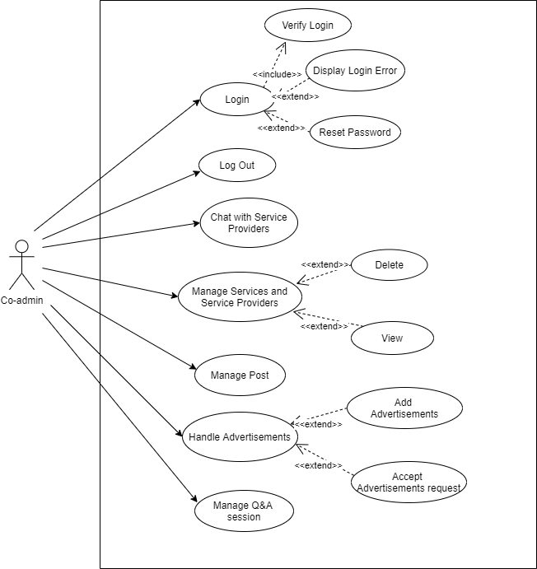
CO-ADMIN

Slide 23
SERVICE
PROVIDER
Register to the system
Deactivate the account.
Chat with co-Admin.
Chat with each other.
Maintain profile.
Ask for advertisements.
Do online payments for advertisements
Engage in a Q & A session
View job posts
Send and cancel job applications sent to the hire person
Manage achievement posts
Accept or reject job invitations

Slide 24
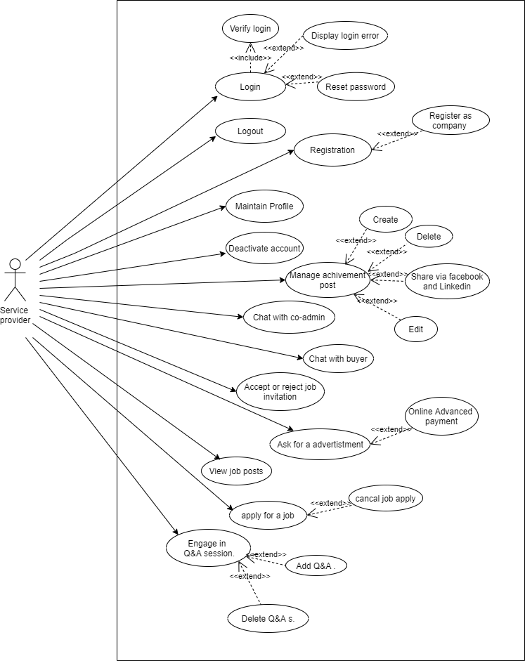
SERVICE
PROVIDER

Slide 25
HIRE PERSON
Register to the system
Deactivate the account.
Chat with co-Admin.
Chat with each other.
Maintain profile.
Ask for advertisements.
Do online payments for advertisements
Engage in a Q & A session
View service providers
Report service provider
Rate and review service providers
Accept or reject job applications
Manage job posts
Send and cancel invitations sent to the service provider

Slide 26
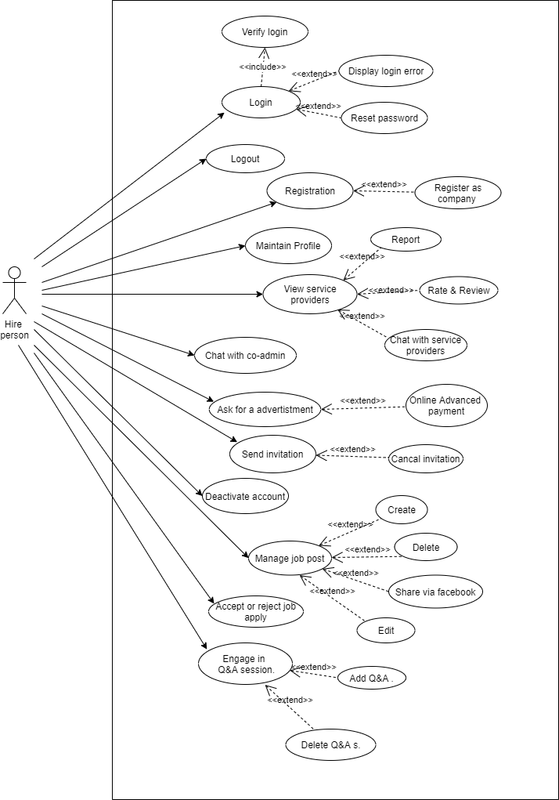
HIRE PERSON

Slide 27

SYSTEM
When looking for service providers or job postings, provide the use of filtering criteria.
Create reports based on the system's current users.
Facilitate the use of an online payment mechanism for advanced advertising payments.
In the case of job applications and invitations, send a notification.

Slide 28

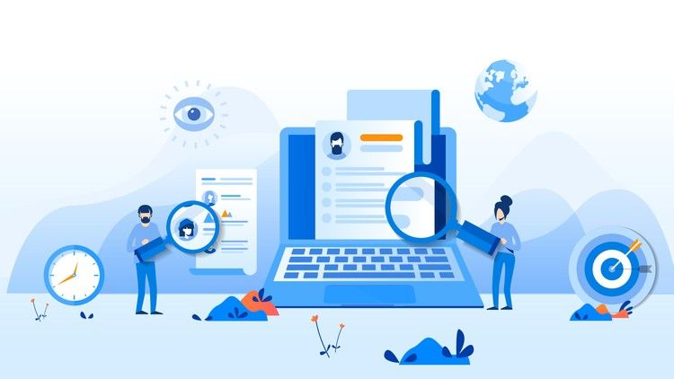
Quality
Attributes ….

Slide 29
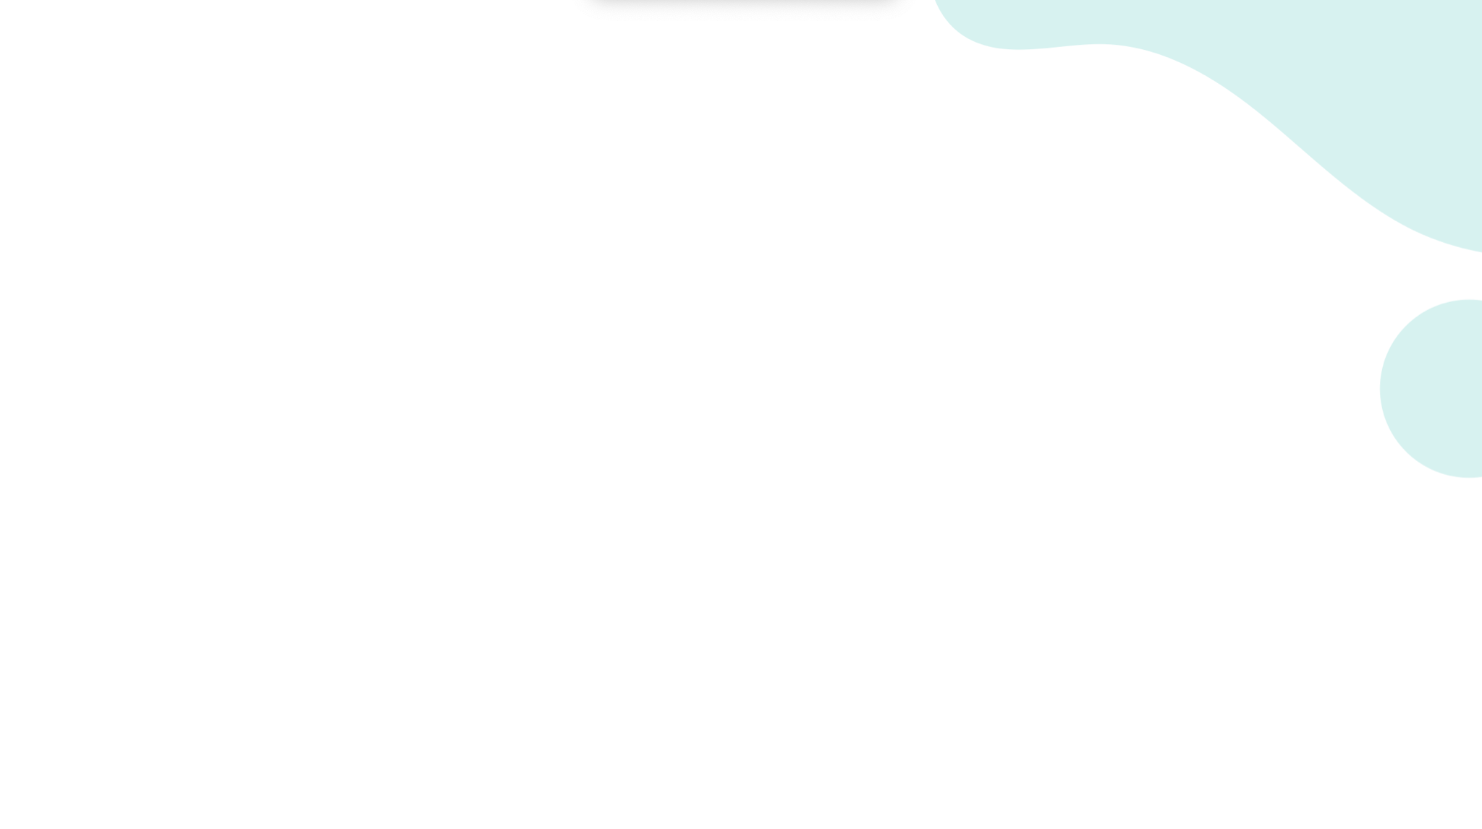






Availability
Modifiability
Usability
Security
Testability
Portability

Slide 30

Quality Attributes
Availability
Users of the system can use the system anytime so, the system should be available 24 hours of the day (Keeping servers available 24/7)

Slide 31
Modifiability
System is made component by component according to the MVC architecture.
Maintain good documentation throughout the development life cycle.
Use remote repositories to keep track of the development.
Follow coding standards and best practices. (Reliability of code blocks,Edit, adding new code blocks, adding comments)
Organized folder structures.
Use up to date technologies for development to improve the longevity of the system.

Slide 32

Usability
User friendly and simple user interfaces.
The developed system can be easily accessed since it is a website.
User friendly and simple user interfaces.
New users can easily learn the procedure of the system.
Easy navigation and developed according to the standard UI principles.
Instructions, tips and examples will be provided in the interface where possible.

Slide 33
Security
Authentication using user accounts.
All login details are sent encrypted.
All credentials in the online payment module are encrypted and trusted vendors will be used. (Online payment will be done through a secure channel)Access control to data records(Security of sensitive data)

Slide 34
Security
System will be planned to backup databases on a given basis, so data loss will not occur.
Each user has his/her own password and a registered email address to be used if a password is lost.
Every change made to the database records by a user will be saved as history within the system and can be viewed by the admin.
The database can be viewed by only the admin and co-admin and any other user does not have access to database information.

Slide 35

Testability
Since the system is modular each component can be tested separately.
Debugging is easier.
Portability
The system is by design of a web application.
Interfaces will support a wide variety of devices and screen resolutions. (Desktop, computers, laptops, tablet computers..etc)

Slide 36




Sub components
Login and authentication
module.
SMS
module
Online payment
module
Report generation
module
Database

Slide 37

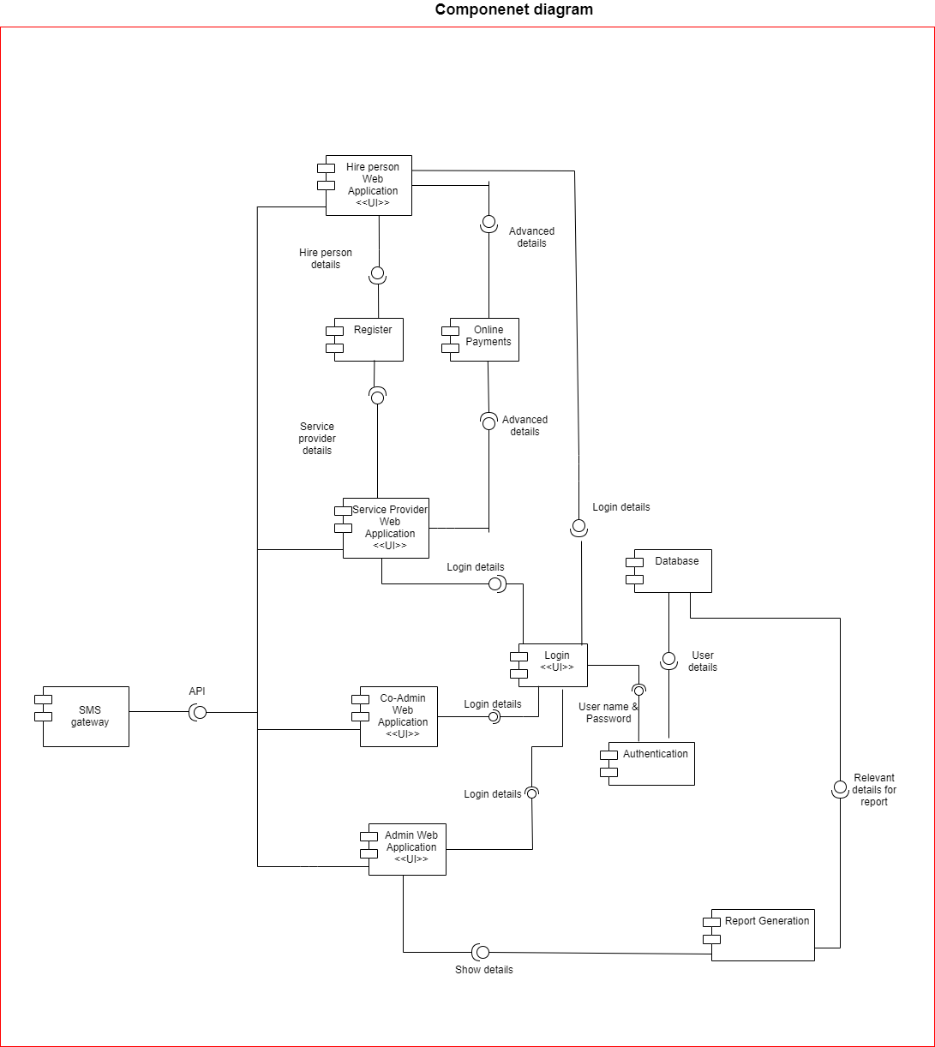
Component diagram
(high level architecture)

Slide 38

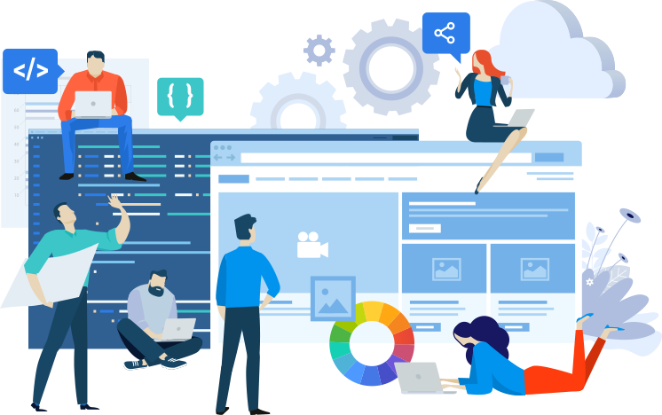
Feasibility
Study …..

Slide 39



Operat
Operational Feasibility
To use the system,
Admin and Co-Admin should have medium knowledge in IT and English
A personal computer with a internet connection
Hire person and Service provider should have basic knowledge in IT.

Slide 40



Technical Feasibility
Required technologies are freely available
Laptops and desktops are already owned by the development team members.
The required technical knowledge of the development team is at satisfied level

Slide 41

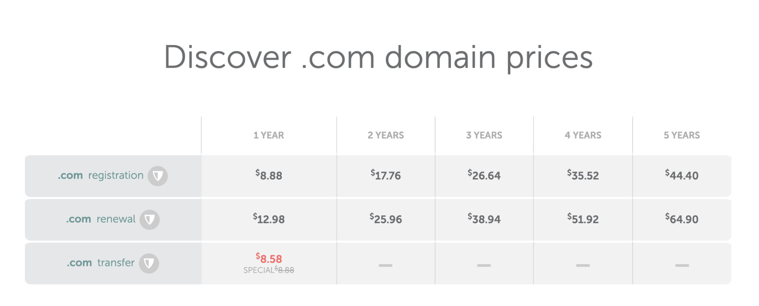
Economic Feasibility
Main costs for proposed system
Domain registration and renewal - year by year
Namecheap rates are comparatively low

Slide 42

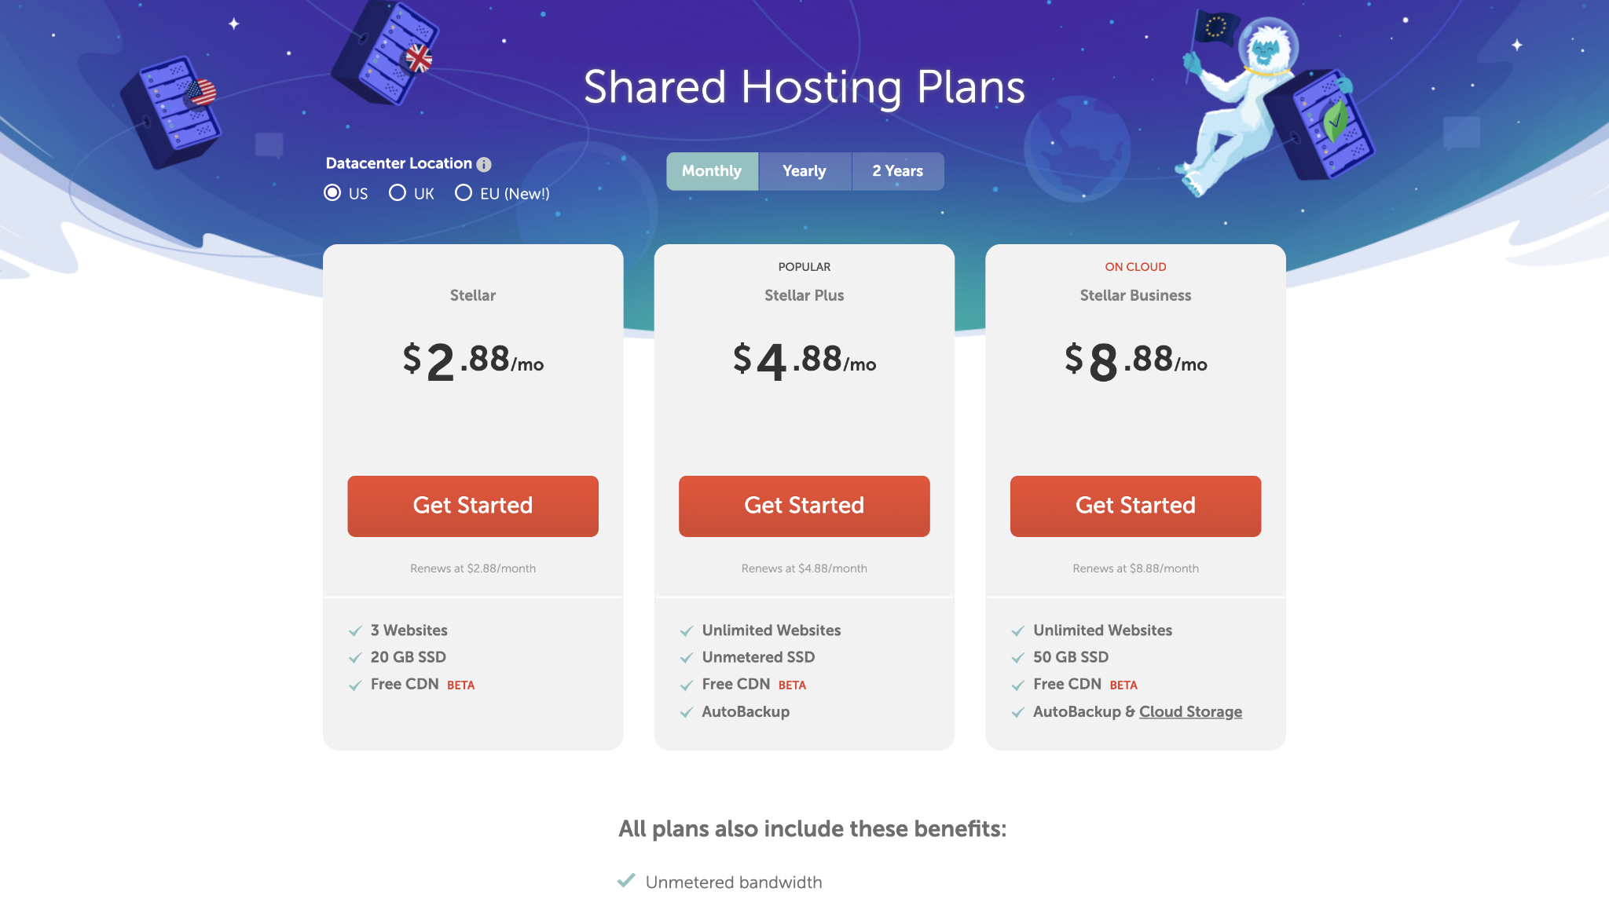
Economic Feasibility
Costs for hosting
Namecheap web server Stellar package - $2.88/mo

Slide 43
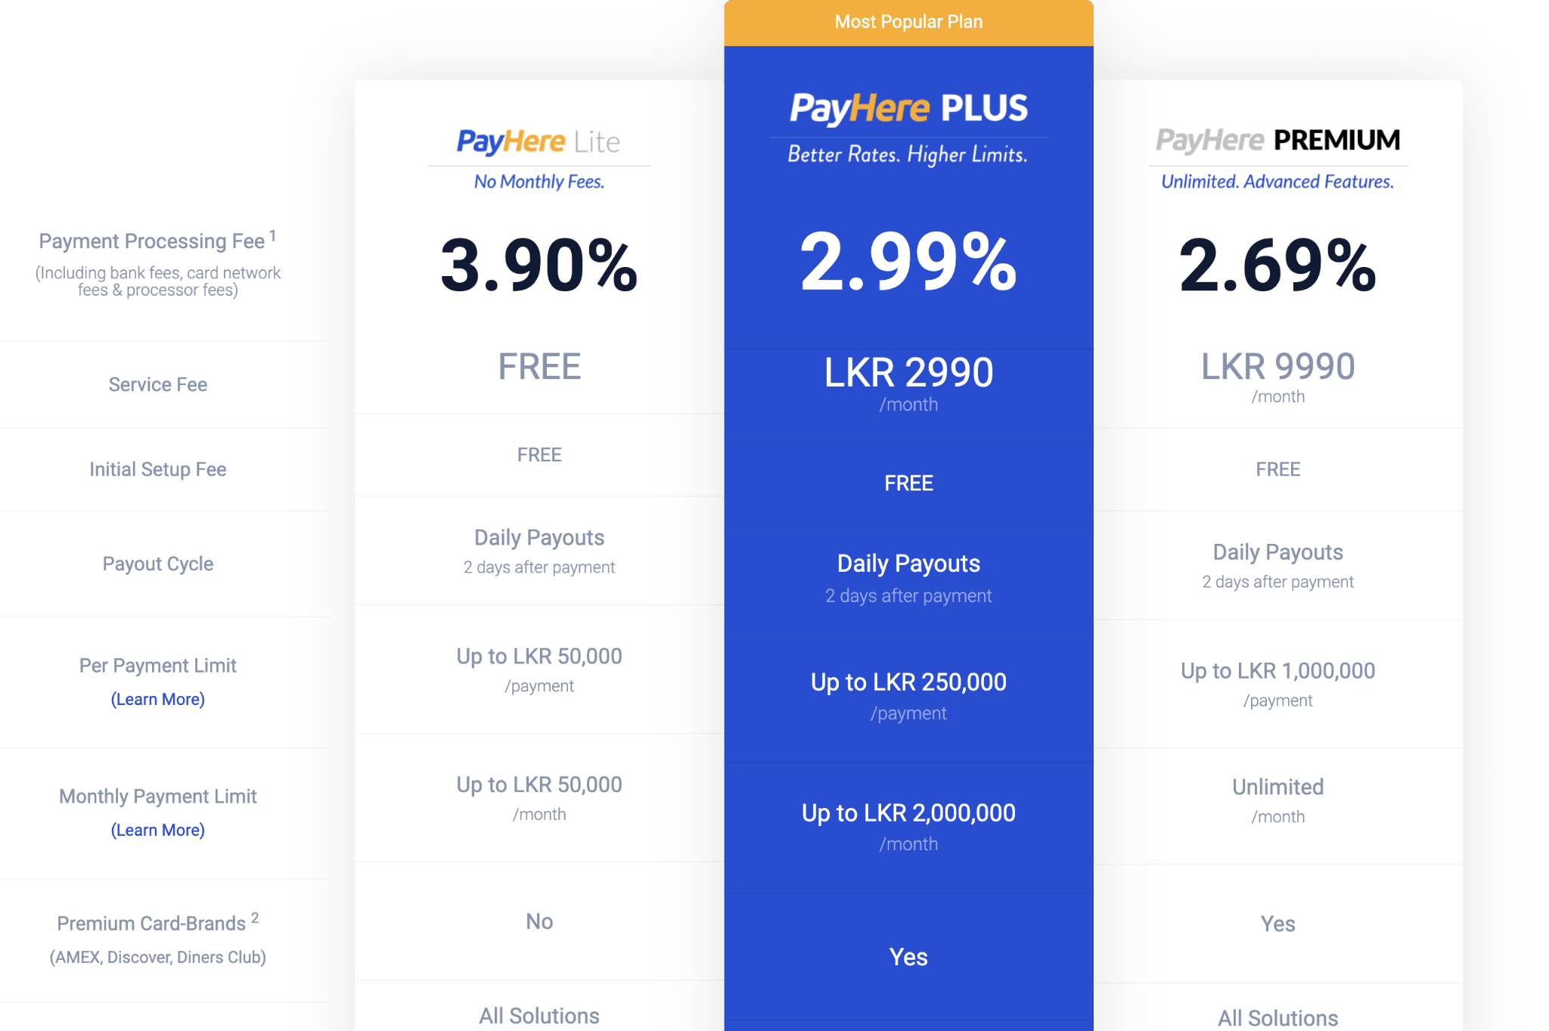
Economic Feasibility
Main costs for proposed system
Cost for PayHere sandbox module - FREE

Slide 44



Economic Feasibility
Other costs:
Cost for communication
Communication via zoom meetings and mobile phones
No cost for software
Free and open source software
No additional hardware cost
Own routers and internet plans will be used

Slide 45



Legal & Ethical Feasibility
All login, credit card details will be sent through an encrypted medium
All transfers will be done with trusted, standardized payment providers
Access to the hire person’s or to the service provider’s details will not be allowed for any user except for the Admin and Co-Admin

Slide 46
Schedule Feasibility
Requirement Analysis
Feasibility Study
Waterfall model
System Design
Implementation
Testing
Deployment

Slide 47
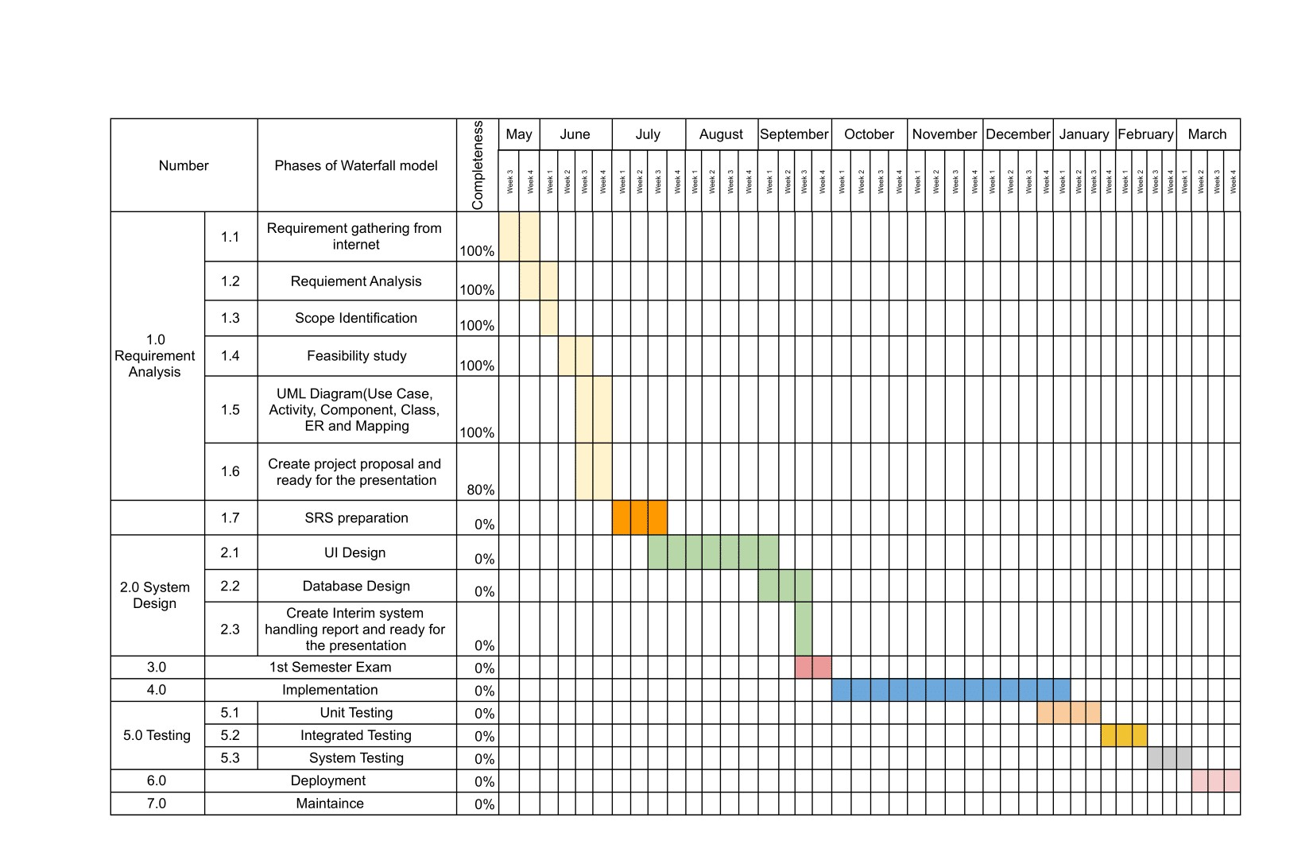


Slide 48



7 hours x 4 Team Members = 28 hours per week
28 hours/week*44 weeks=
1232 hours

Slide 49

Limitations and Constraints
The product shall be finished within 10 months according to the period of time. Although due to the current Covid-19 situation the period of time may adjust varyingly.
All 4 members of the group possess the same skills and abilities in terms of software development.
No frameworks are allowed to be used. So, the project will be hard coded.
In terms of the system, we assume that:
All the users of the system have satisfactory IT and English knowledge to use the system. Though this system is made for IT service providers and those who want to hire them, we assume those people already have good IT and English knowledge.

Slide 50

In terms of hardware, the PC, Laptop, or Mobile phone can be logged into the system and can use the system.
Online payments will be done through a secure channel.
When the user (Service provider or hire person) makes online payments, he should give an online receipt to the co-admin in order to proceed forward.
When the user (Service provider or hire person) is unable to pay online advanced payments they can do it offline(through a bank) by contacting the co-admin of the system.

Slide 51





Technologies to be used

Slide 52


DATABASE

Slide 53
Front end
Back end

Slide 54


Modules
Collaboration Tools

Slide 55


Version Controlling

Slide 56
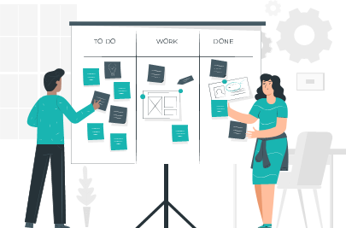
Work division between
group members
All work is to be divided according to the user roles of the system.
H L Harith Iduwara | All the parts of the system related to the Hire person.
V D L Wathsala Vithanage | All the parts of the system related to the Service provider.
D G Hansika Kumari | All the parts of the system related to the Co Admin.
S S Malsha | All the parts of the system related to the Admin.

Slide 57

Q & A

Slide 58
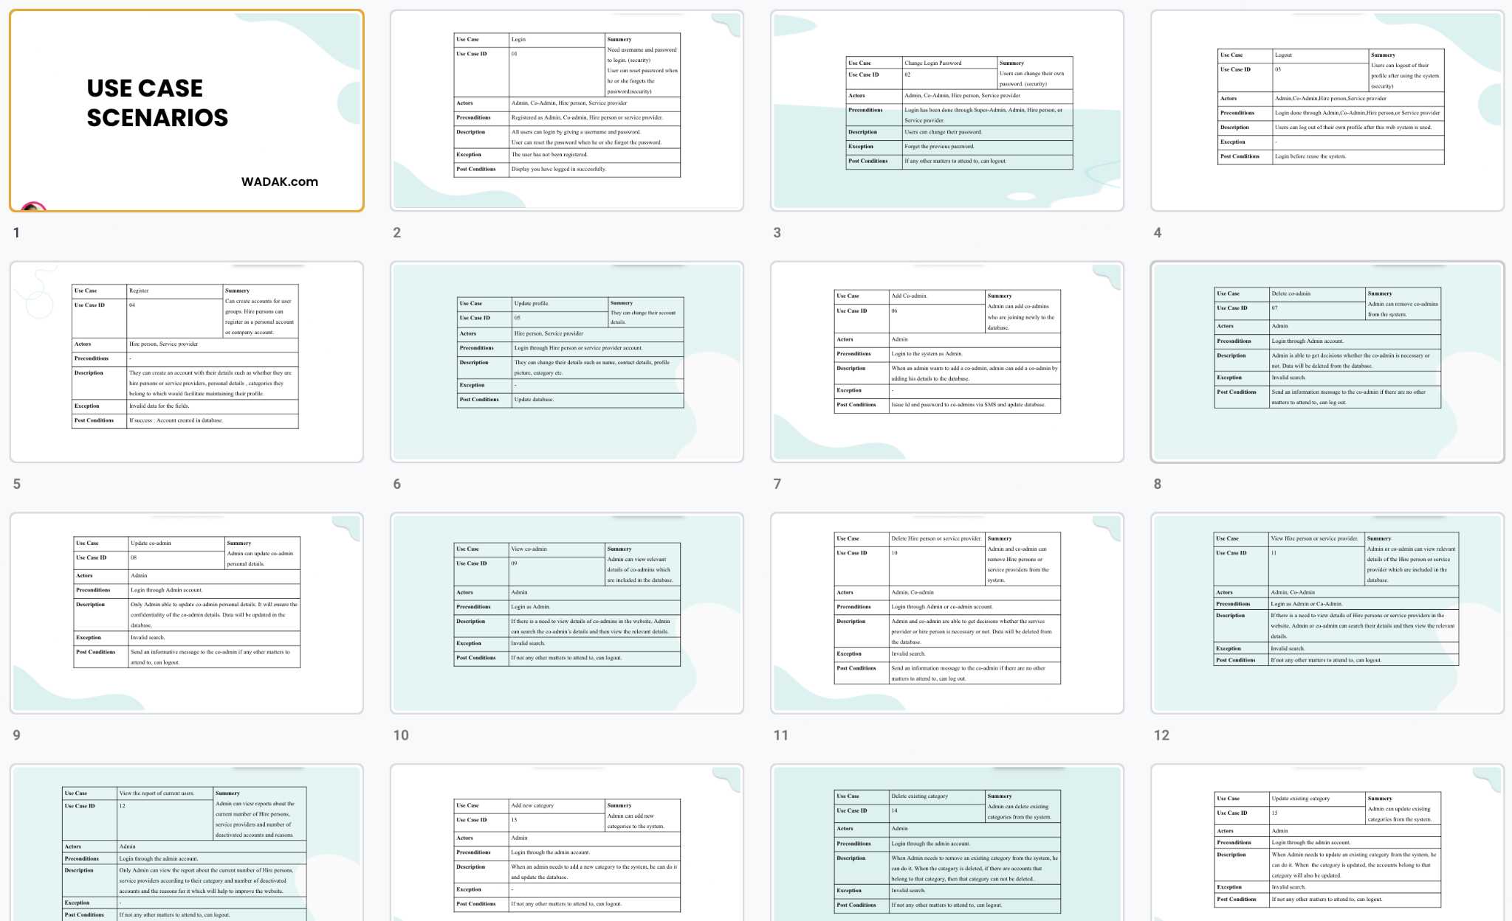
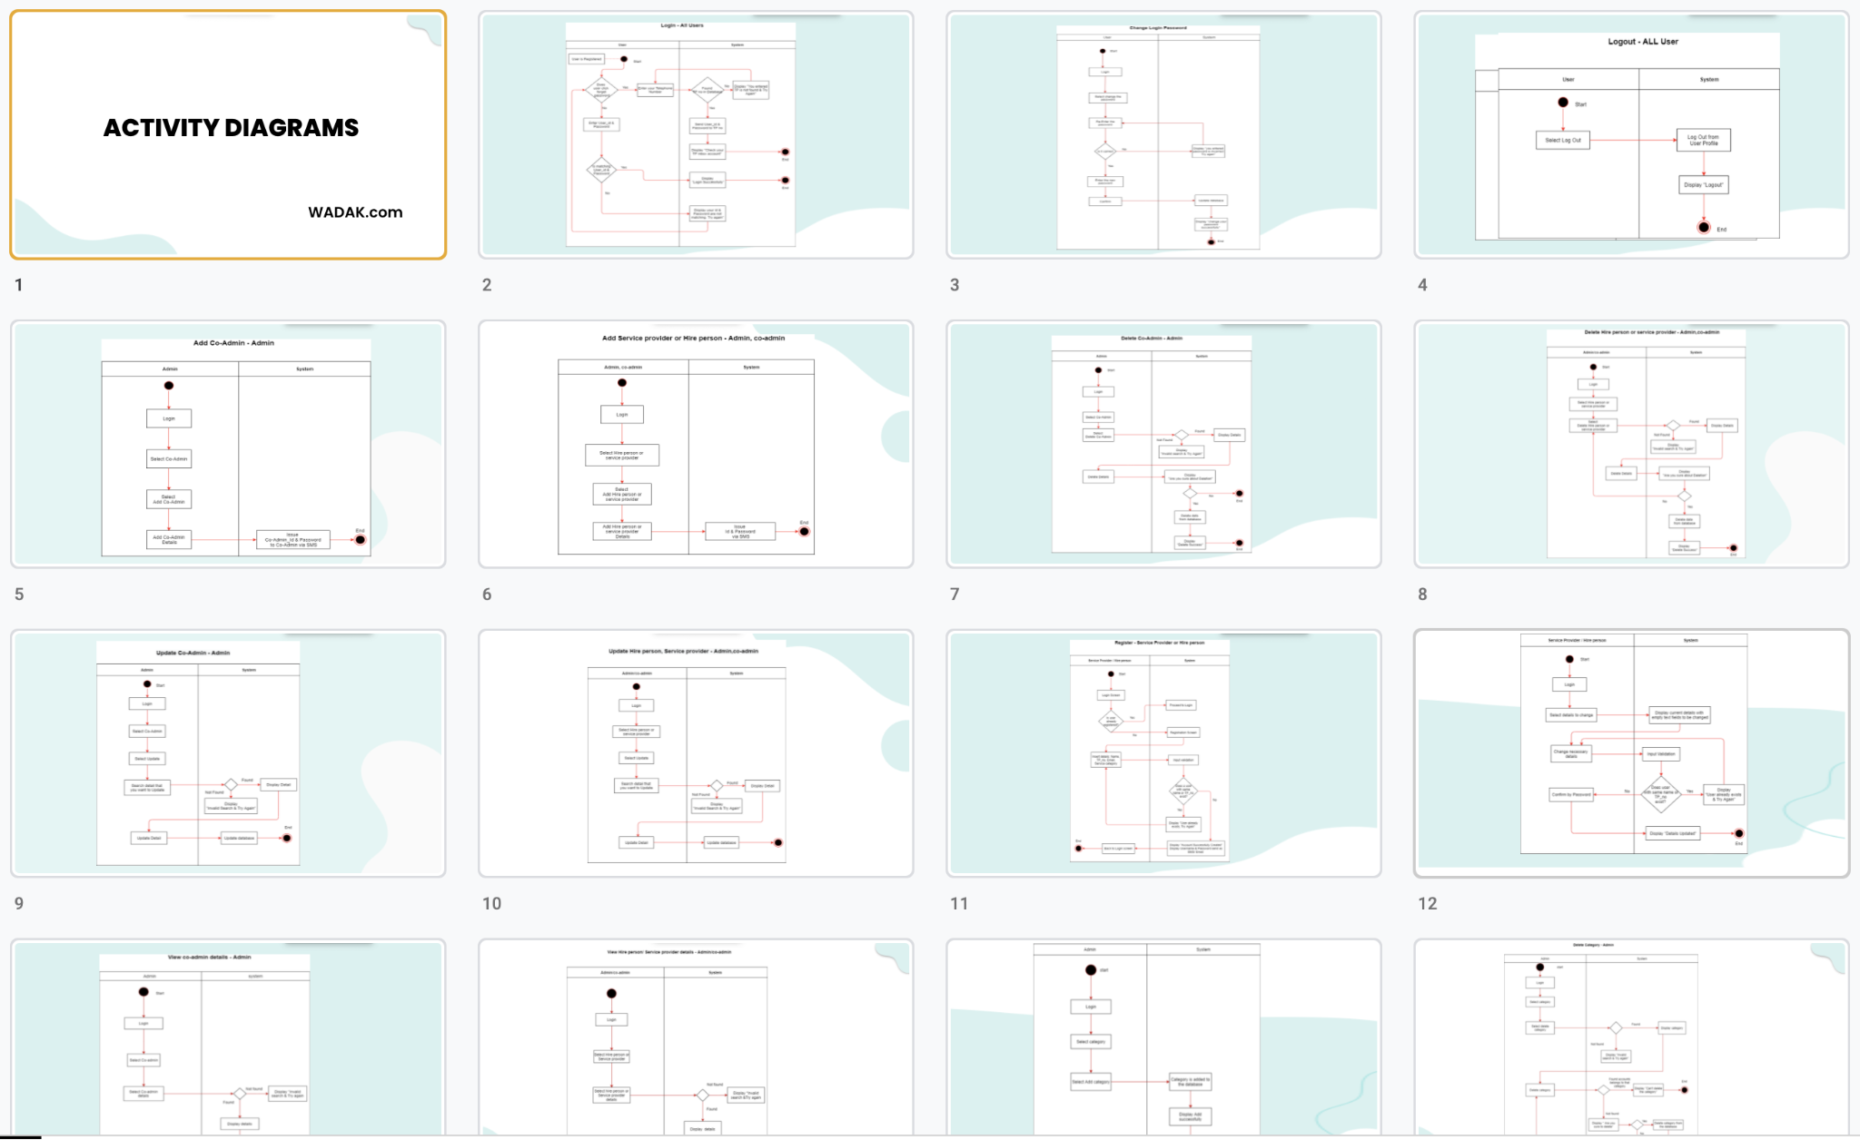
CREATE A SURVEY AND ADD IMAGES
USE CASE SCENARIOS
ACTIVITY DIAGRAMS

Slide 59
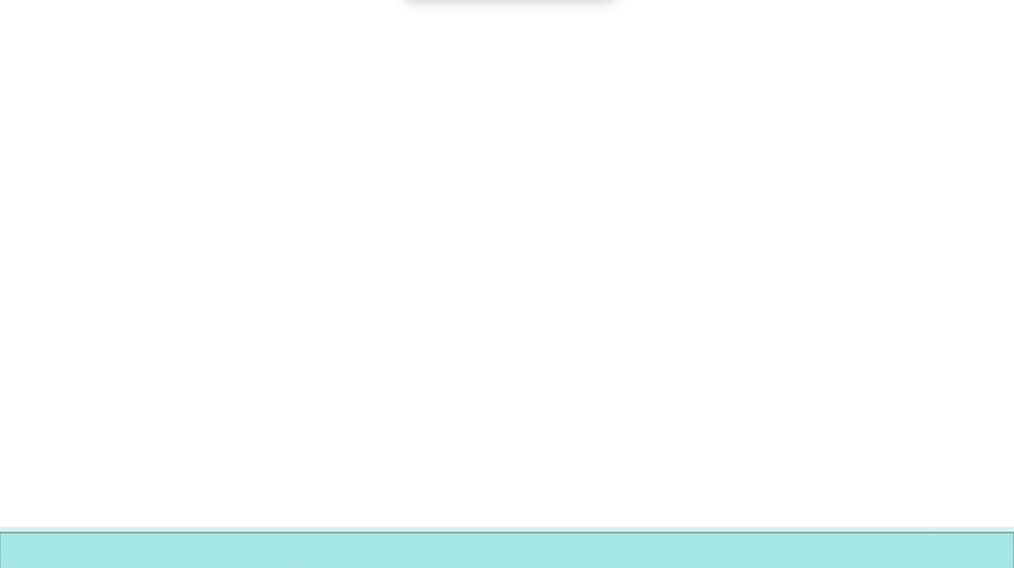
Thank you!

Slide 60
To be continued….

Slide 61
USE CASE SCENARIOS

Slide 62
Use Case | Login | Summery Need username and password to login. (security) User can reset password when he or she forgets the password(security)
Use Case ID | 01
Actors | Admin, Co-Admin, Hire person, Service provider
Preconditions | Registered as Admin, Co-admin, Hire person or service provider.
Description | All users can login by giving a username and password. User can reset the password when he or she forgot the password.
Exception | The user has not been registered.
Post Conditions | Display you have logged in successfully.

Slide 63
Use Case | Change Login Password | Summery Users can change their own password. (security)
Use Case ID | 02
Actors | Admin, Co-Admin, Hire person, Service provider
Preconditions | Login has been done through Super-Admin, Admin, Hire person, or Service provider.
Description | Users can change their password.
Exception | Forget the previous password.
Post Conditions | If any other matters to attend to, can logout.

Slide 64
Use Case | Logout | Summery Users can logout of their profile after using the system. (security)
Use Case ID | 03
Actors | Admin,Co-Admin,Hire person,Service provider
Preconditions | Login done through Admin,Co-Admin,Hire person,or Service provider
Description | Users can log out of their own profile after this web system is used.
Exception | -
Post Conditions | Login before reuse the system.

Slide 65
Use Case | Register | Summery Can create accounts for user groups. Hire persons can register as a personal account or company account.
Use Case ID | 04
Actors | Hire person, Service provider
Preconditions | -
Description | They can create an account with their details such as whether they are hire persons or service providers, personal details , categories they belong to which would facilitate maintaining their profile.
Exception | Invalid data for the fields.
Post Conditions | If success : Account created in database.

Slide 66


Use Case | Update profile. | Summery They can change their account details.
Use Case ID | 05
Actors | Hire person, Service provider
Preconditions | Login through Hire person or service provider account.
Description | They can change their details such as name, contact details, profile picture, category etc.
Exception | -
Post Conditions | Update database.

Slide 67
Use Case | Add Co-admin. | Summery Admin can add co-admins who are joining newly to the database.
Use Case ID | 06
Actors | Admin
Preconditions | Login to the system as Admin.
Description | When an admin wants to add a co-admin, admin can add a co-admin by adding his details to the database.
Exception | -
Post Conditions | Issue Id and password to co-admins via SMS and update database.

Slide 68
Use Case | Delete co-admin | Summery Admin can remove co-admins from the system.
Use Case ID | 07
Actors | Admin
Preconditions | Login through Admin account.
Description | Admin is able to get decisions whether the co-admin is necessary or not. Data will be deleted from the database.
Exception | Invalid search.
Post Conditions | Send an information message to the co-admin if there are no other matters to attend to, can log out.

Slide 69
Use Case | Update co-admin | Summery Admin can update co-admin personal details.
Use Case ID | 08
Actors | Admin
Preconditions | Login through Admin account.
Description | Only Admin able to update co-admin personal details. It will ensure the confidentiality of the co-admin details. Data will be updated in the database.
Exception | Invalid search.
Post Conditions | Send an informative message to the co-admin if any other matters to attend to, can logout.

Slide 70
Use Case | View co-admin | Summery Admin can view relevant details of co-admins which are included in the database.
Use Case ID | 09
Actors | Admin
Preconditions | Login as Admin.
Description | If there is a need to view details of co-admins in the website, Admin can search the co-admin’s details and then view the relevant details.
Exception | Invalid search.
Post Conditions | If not any other matters to attend to, can logout.

Slide 71
Use Case | Delete Hire person or service provider. | Summery Admin and co-admin can remove Hire persons or service providers from the system.
Use Case ID | 10
Actors | Admin, Co-admin
Preconditions | Login through Admin or co-admin account.
Description | Admin and co-admin are able to get decisions whether the service provider or hire person is necessary or not. Data will be deleted from the database.
Exception | Invalid search.
Post Conditions | Send an information message to the co-admin if there are no other matters to attend to, can log out.

Slide 72
Use Case | View Hire person or service provider. | Summery Admin or co-admin can view relevant details of the Hire person or service provider which are included in the database.
Use Case ID | 11
Actors | Admin, Co-Admin
Preconditions | Login as Admin or Co-Admin.
Description | If there is a need to view details of Hire persons or service providers in the website, Admin or co-admin can search their details and then view the relevant details.
Exception | Invalid search.
Post Conditions | If not any other matters to attend to, can logout.

Slide 73
Use Case | View the report of current users. | Summery Admin can view reports about the current number of Hire persons, service providers and number of deactivated accounts and reasons.
Use Case ID | 12
Actors | Admin
Preconditions | Login through the admin account.
Description | Only Admin can view the report about the current number of Hire persons, service providers according to their category and number of deactivated accounts and the reasons for it which will help to improve the website.
Exception | -
Post Conditions | If not any other matters to attend to, can logout.

Slide 74
Use Case | Add new category | Summery Admin can add new categories to the system.
Use Case ID | 13
Actors | Admin
Preconditions | Login through the admin account.
Description | When an admin needs to add a new category to the system, he can do it and update the database.
Exception | -
Post Conditions | If not any other matters to attend to, can logout.

Slide 75
Use Case | Delete existing category | Summery Admin can delete existing categories from the system.
Use Case ID | 14
Actors | Admin
Preconditions | Login through the admin account.
Description | When Admin needs to remove an existing category from the system, he can do it. When the category is deleted, if there are accounts that belong to that category, then that category can not be deleted..
Exception | Invalid search.
Post Conditions | If not any other matters to attend to, can logout.

Slide 76
Use Case | Update existing category | Summery Admin can update existing categories from the system.
Use Case ID | 15
Actors | Admin
Preconditions | Login through the admin account.
Description | When Admin needs to update an existing category from the system, he can do it. When the category is updated, the accounts belong to that category will also be updated.
Exception | Invalid search.
Post Conditions | If not any other matters to attend to, can logout.

Slide 77
Use Case | Chat with Hire persons or service providers. | Summery If there is an issue or fact that hiring persons or service providers arise, co-admin can give advice through the chat section.
Use Case ID | 16
Actors | Co-admin
Preconditions | Login as co-admin.
Description | Co-admins can communicate with hire persons or service providers through the chat section.
Exception | -
Post Conditions | If not any other matters to attend to, can logout.

Slide 78
Use Case | Chat with co-admins. | Summery If there is an issue or fact that needs to be clarified, hire persons and service providers can contact co-admins through the chat section.
Use Case ID | 17
Actors | Service provider or hire person.
Preconditions | Login as service provider or hire person.
Description | Hire persons or service providers can communicate with co-admins through the chat section.
Exception | -
Post Conditions | If not any other matters to attend to, can logout.

Slide 79
Use Case | Chat with service providers or hire persons. | Summery If there is an issue or fact that needs to be clarified, hire persons and service providers can contact each other through the chat section of the service provider.
Use Case ID | 18
Actors | Service provider or hire person.
Preconditions | Login as a service provider or a hire person.
Description | Hire persons or service providers can communicate with each other through the chat section of the service provider.
Exception | -
Post Conditions | If no other matters to attend to, can log out.

Slide 80
Use Case | Deactivate the account | Summery Hire person, Service provider can deactivate their account if they do not want to be available in the system anymore.
Use Case ID | 19
Actors | Hire person, Service provider.
Preconditions | Log in as a service provider or a hire person.
Description | Hire person, Service provider can close their account if they do not want to be available in the system anymore by selecting the reason for account deactivation. Data will be deleted from the database.
Exception | Do not select reasons through provided reasons.
Post Conditions | If no other matters to attend to, the account is deactivated.

Slide 81
Use Case | Create job post | Summery Hire people can create job posts according to their perspectives.
Use Case ID | 20
Actors | Hire person
Preconditions | Login through a hire person account.
Description | Hire people can create job posts after selecting relevant categories.
Exception | Do not select a category.
Post Conditions | Post is created and can be viewed.

Slide 82
Use Case | Delete or edit a job post | Summery Hire people can delete or edit job posts according to their perspective.
Use Case ID | 21
Actors | Hire person
Preconditions | Login through a hire person account and a post must be created before.
Description | Hire persons can delete or edit job posts after creating them.
Exception | -
Post Conditions | The post is deleted or edited.

Slide 83
Use Case | Share job post | Summery Hire persons who can share their job posts through facebook.
Use Case ID | 22
Actors | Hire person
Preconditions | Login through a hire person account.
Description | Hire persons can share their job posts through facebook.
Exception | Do not login into the relevant facebook account.
Post Conditions | Post is shared.

Slide 84
Use Case | Create an achievement post. | Summery Service providers can create achievement posts according to their perspectives.
Use Case ID | 23
Actors | Service provider.
Preconditions | Login through a service provider account.
Description | Service providers can create achievement posts.
Exception | -
Post Conditions | Post is created and can be viewed.

Slide 85
Use Case | Delete or edit an achievement post. | Summery Service providers can delete or edit achievement posts according to their perspectives.
Use Case ID | 24
Actors | Service provider.
Preconditions | Login through a service provider account and a post must be created before.
Description | Service providers can delete or edit their achievement posts created before.
Exception | -
Post Conditions | Post is deleted or edited.

Slide 86
Use Case | Share job post | Summery Hire people can share their achievement posts through facebook.
Use Case ID | 25
Actors | Service provider.
Preconditions | Login through a service provider account and post must be created before.
Description | Service providers can share their achievement posts through facebook.
Exception | Do not login into the relevant facebook account.
Post Conditions | Post is shared.

Slide 87
Use Case | Manage post | Summery Co-admin can manage both posts including job posts and achievement posts.
Use Case ID | 26
Actors | Co-admin
Preconditions | Login through a Co-admin account.
Description | If there are posts that are not related to the system, the co-admin can delete those posts.
Exception | -
Post Conditions | Post is deleted.

Slide 88
Use Case | Rate and review service provider | Summery Hire people can rate and review service providers in the service provider’s profile.
Use Case ID | 27
Actors | Hire person
Preconditions | Login as hire person
Description | Hire person can rate and review the service providers. These two options are available in service providers profiles.
Exception | -
Post Conditions | Rate is done and review is created.

Slide 89
Use Case | Report service provider | Summery Hire people can report service providers in the service provider’s profile.
Use Case ID | 28
Actors | Hire person
Preconditions | Login as hire person
Description | Hire persons can rate and review service providers. These two options are available in service provider profiles.
Exception | -
Post Conditions | Rate is done and review is done..

Slide 90
Use Case | Send an invitation. | Summery Hire person can send an invitation to the service provider.
Use Case ID | 29
Actors | Hire person.
Preconditions | Login as a hire person and should be in the service provider’s profile.
Description | A hire person can send an invitation to the service provider by filling in relevant details.
Exception | Do not fill out the invitation details.
Post Conditions | Invitation is sent.

Slide 91
Use Case | Cancel an invitation. | Summery Hire person can cancel the previously sent invitation to the service provider.
Use Case ID | 30
Actors | Hire a person.
Preconditions | Login as a hire person.
Description | The Hired person can cancel the previously sent invitation to the service provider.
Exception | -
Post Conditions | Invitation is canceled.

Slide 92
Use Case | Accept or reject job apply for a post. | Summery Hire person can accept or reject job applications sent by service providers.
Use Case ID | 31
Actors | Hire a person.
Preconditions | Log in as a hire person.
Description | The Hire person can send an invitation to the service provider by filling relevant details.
Exception | -
Post Conditions | Job application is accepted or rejected.

Slide 93
Use Case | Apply for a job post. | Summery The service provider can apply for a job post created by a hire person.
Use Case ID | 32
Actors | Service provider.
Preconditions | Log in through a service provider account.
Description | The service provider can apply for a job post created by a Hire person.
Exception | Do not fill in relevant details.
Post Conditions | Job apply is sent.

Slide 94
Use Case | Accept or reject job invitation. | Summery Service providers can accept or reject job invitations sent by a Hire person.
Use Case ID | 33
Actors | Service provider.
Preconditions | Login through a service provider account.
Description | Service providers can accept or reject job invitations sent by a Hire person.
Exception | -
Post Conditions | Job invitation is accepted or rejected.

Slide 95
Use Case | Add Q&A | Summery Hire persons and service providers can add Q&A in the Q&A section.
Use Case ID | 34
Actors | Hire person, Service provider
Preconditions | Login as a hire person or a service provider.
Description | Both hire persons and service providers can publish their questions in the Q&A session as well as can reply to the questions.
Exception | -
Post Conditions | Q&A is published.

Slide 96
Use Case | Delete Q&A | Summery Hire persons and service providers can delete Q&A in the Q&A section.
Use Case ID | 35
Actors | Hire person, Service provider
Preconditions | Login as a hire person or a service provider./Q&A must be published before.
Description | Both hire persons and service providers can delete their published questions in the Q&A session as well as delete replies to the questions.
Exception | -
Post Conditions | Q&A is deleted.

Slide 97
Use Case | Manage Q&A sessions. | Summery Co-admin can delete Q&A s in the Q & A section.
Use Case ID | 36
Actors | Co-admin
Preconditions | Login as a co-admin.
Description | If there are Q&As which are not related to the system, the co-admin can delete those Q&A from the system.
Exception | -
Post Conditions | Q&A is deleted

Slide 98
Use Case | Ask for a advertisement | Summery Both hired persons or service providers can request for their image(png or jpeg format) advertisement.
Use Case ID | 37
Actors | Hire person, Service provider
Preconditions | Login as a hire person or service provider.
Description | Both hired persons or service providers can request for their image(png or jpeg format) advertisement.
Exception | Did not fill the required sections.
Post Conditions | Request is sent.

Slide 99
Use Case | Online advanced payments. | Summery Can pay advance even online (quality)
Use Case ID | 38
Actors | Hire person, Service provider
Preconditions | Should be in “Apply advertisement”
Description | Users can select a payment method and pay the advance. All authentication will be handled by the online payment module.
Exception | Payment method error, Insufficient balance.
Post Conditions | If success: perform transaction

Slide 100
ACTIVITY DIAGRAMS

Slide 101
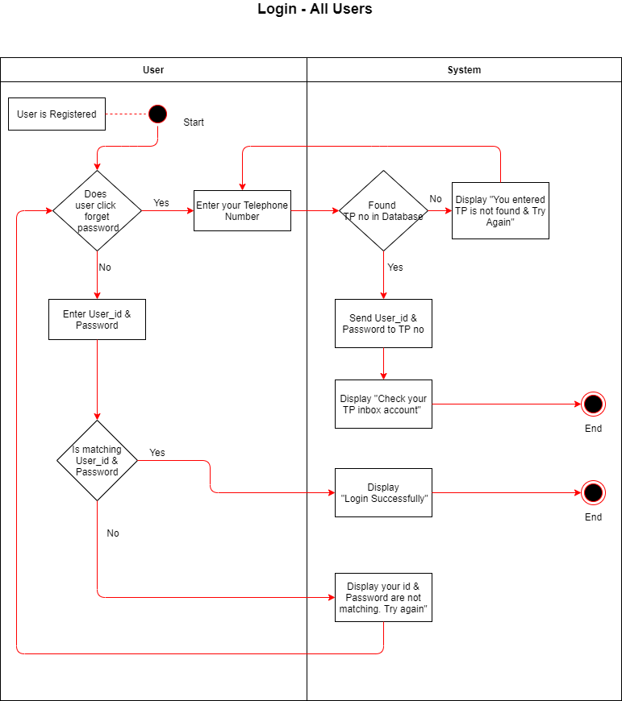

Slide 102
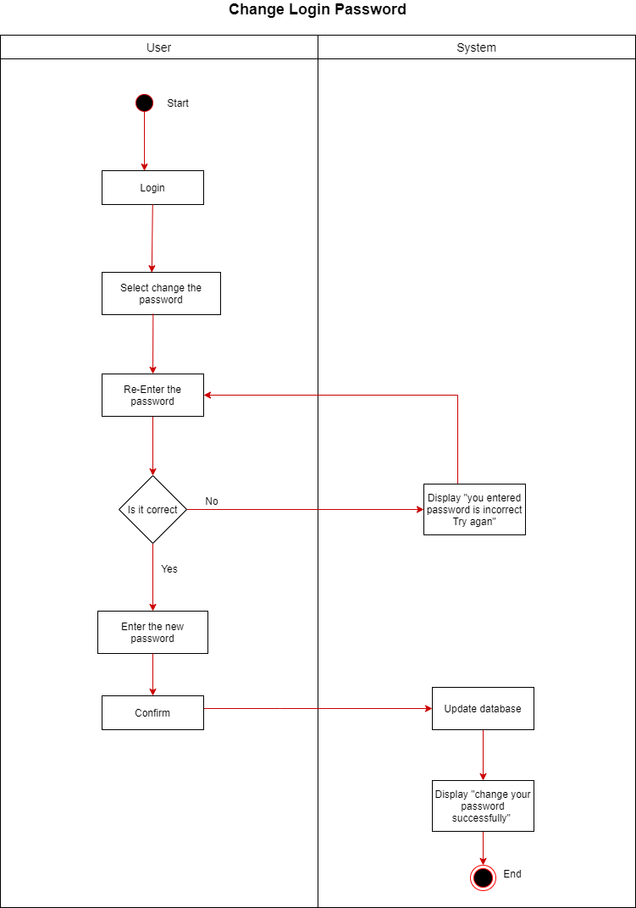

Slide 103
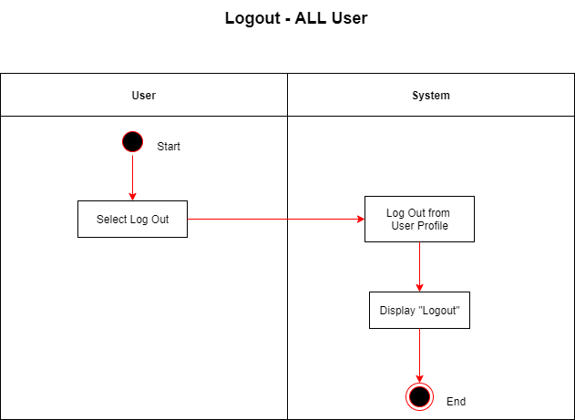

Slide 104
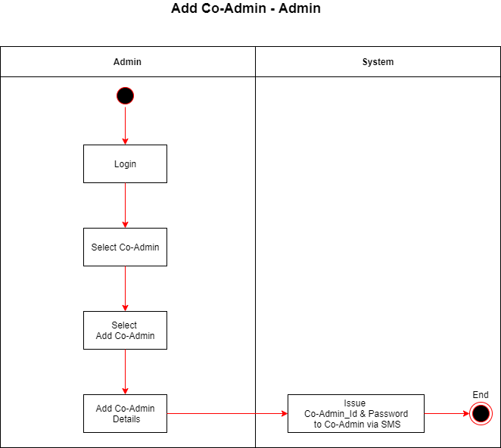

Slide 105
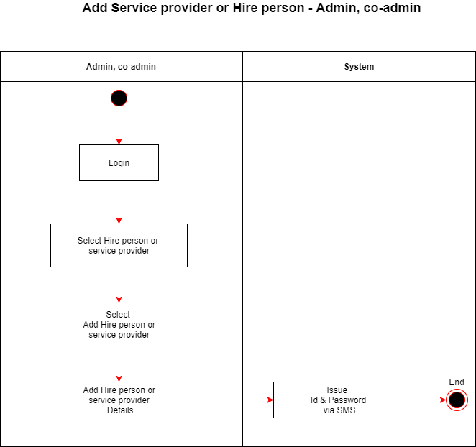

Slide 106
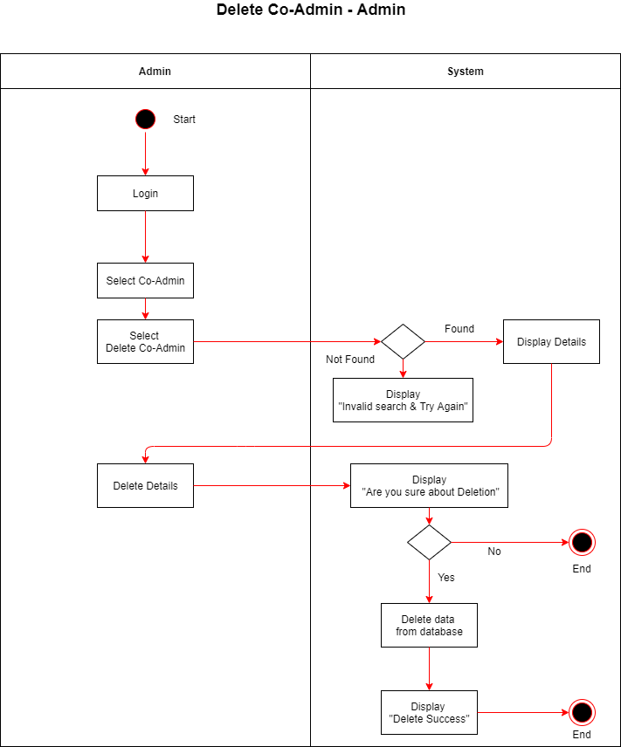

Slide 107
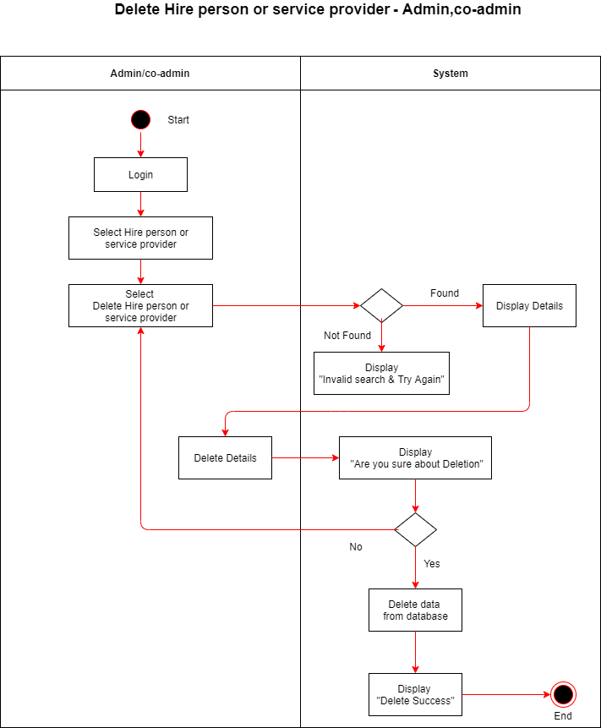

Slide 108
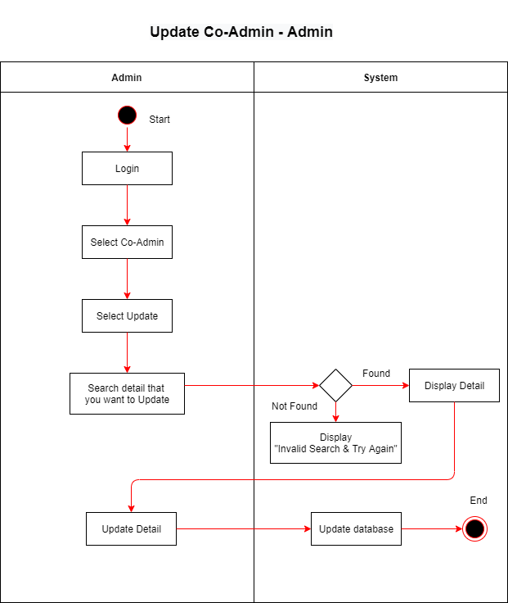

Slide 109
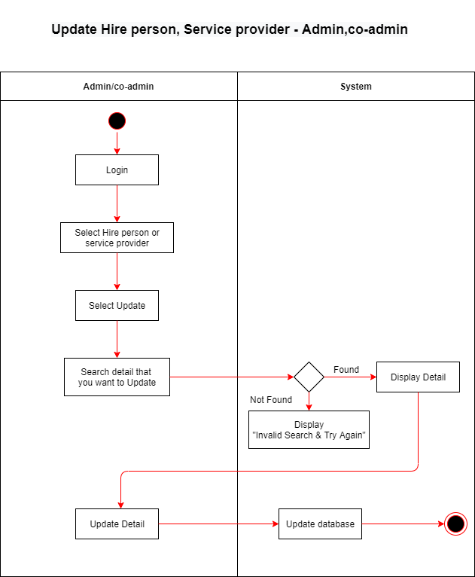

Slide 110
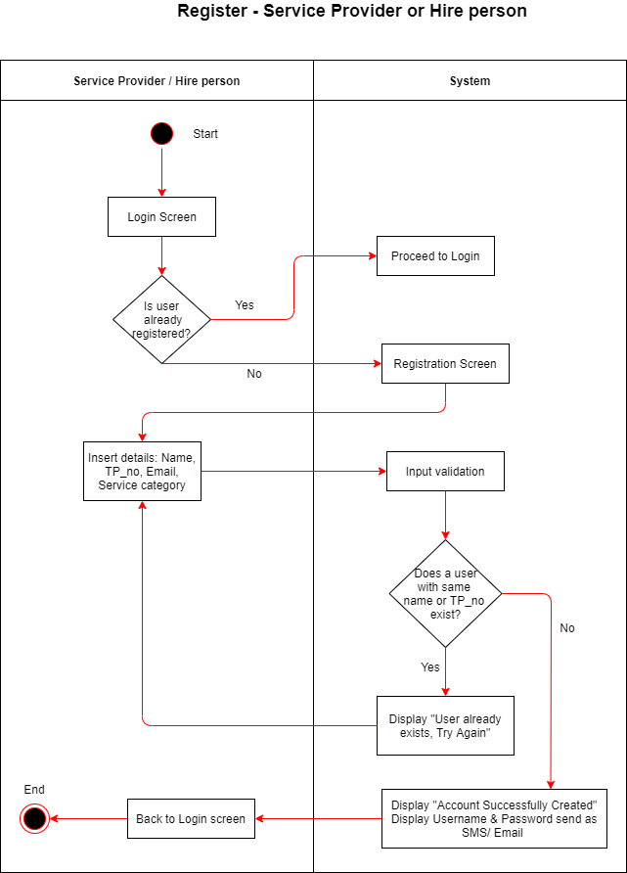

Slide 111
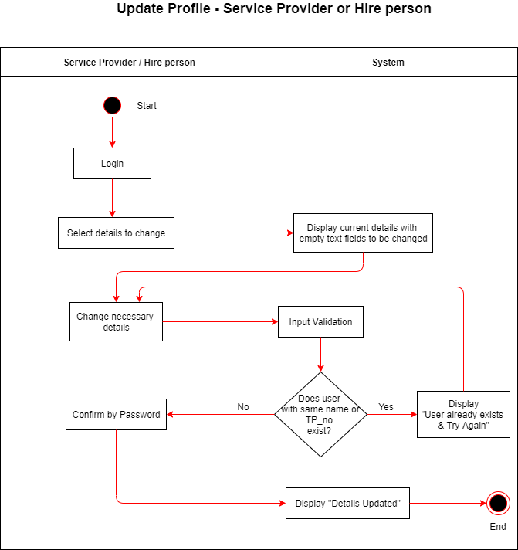

Slide 112
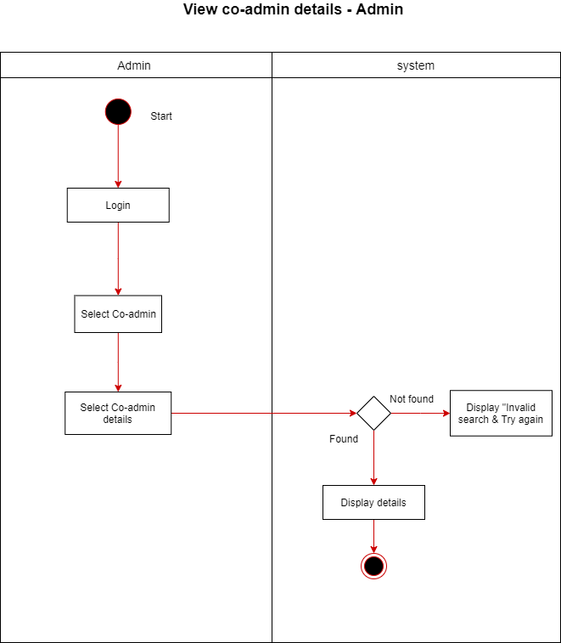

Slide 113
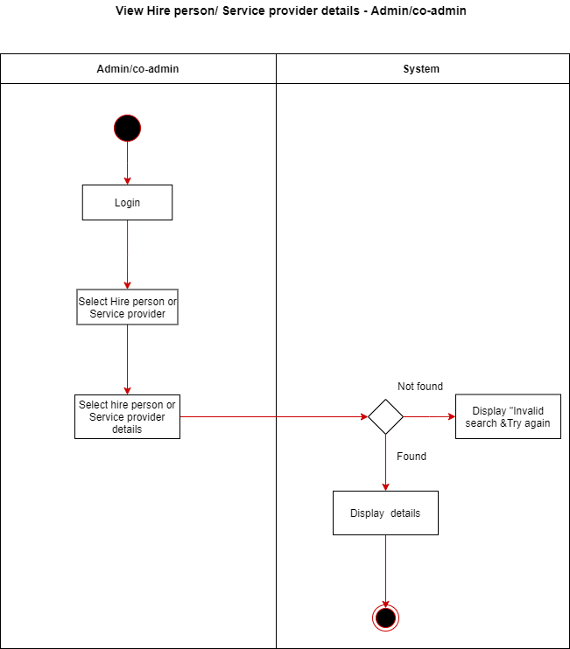

Slide 114
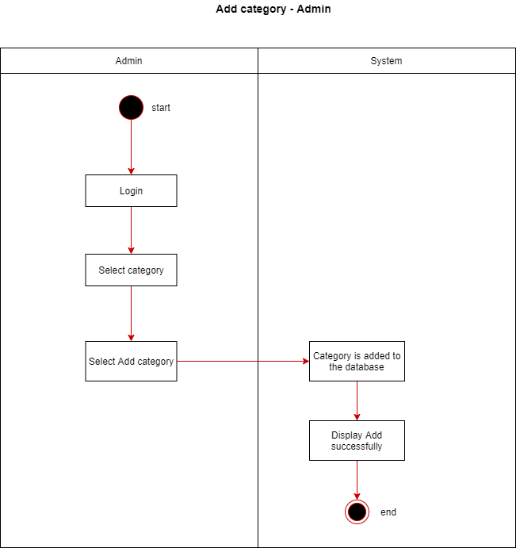

Slide 115
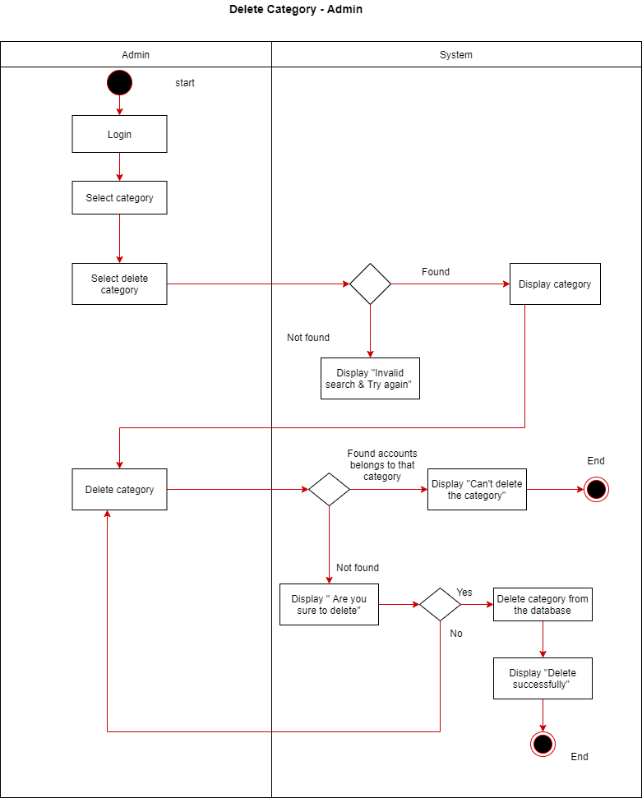

Slide 116
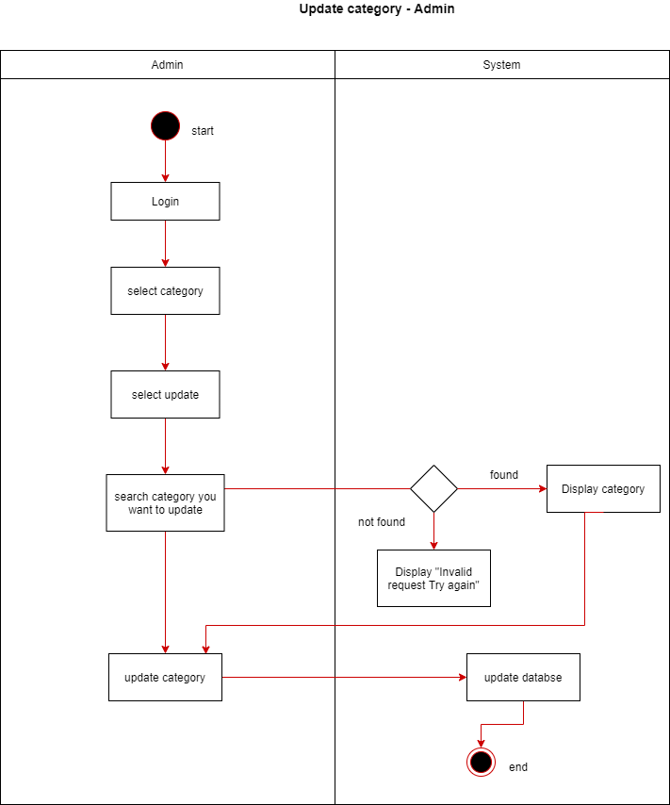

Slide 117
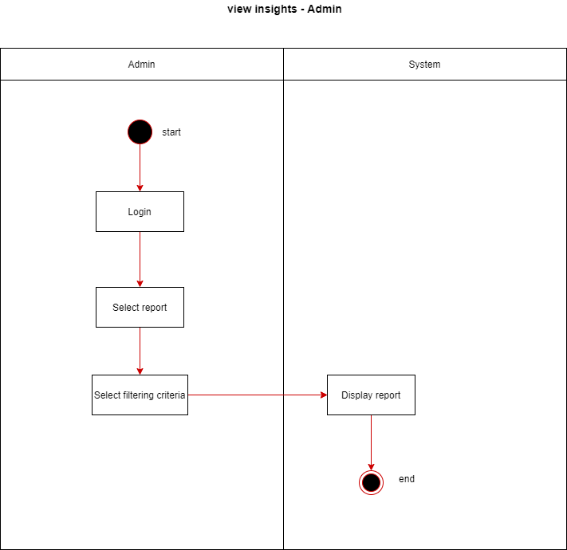

Slide 118
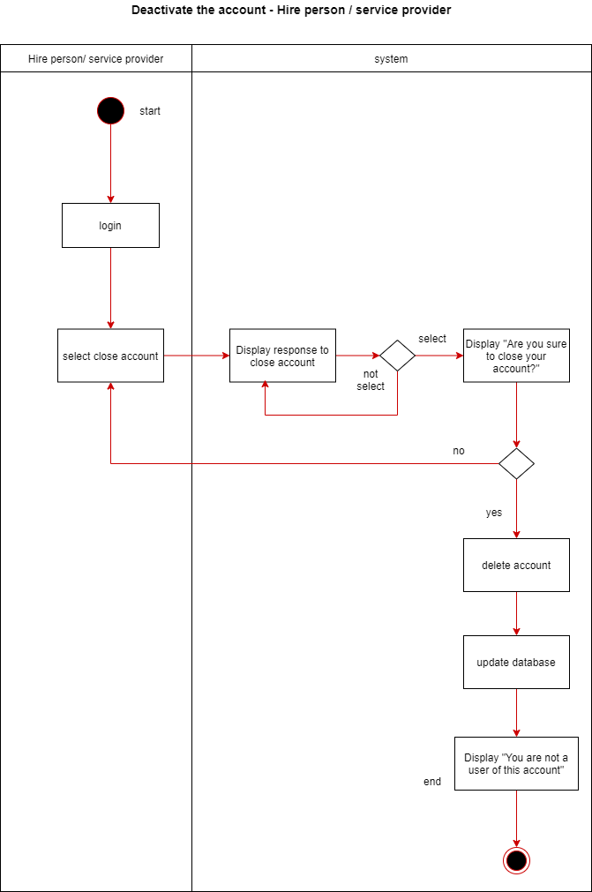

Slide 119
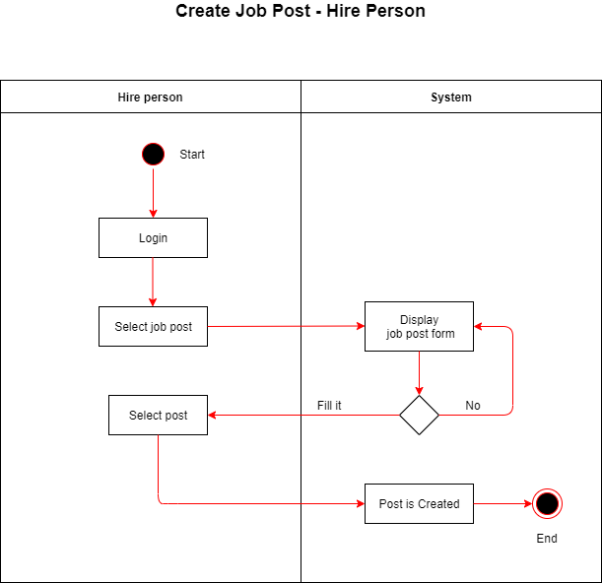

Slide 120
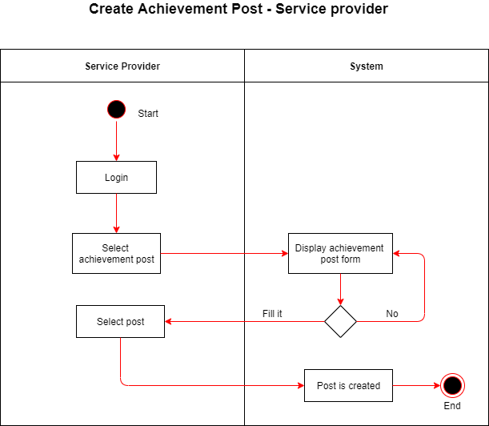

Slide 121
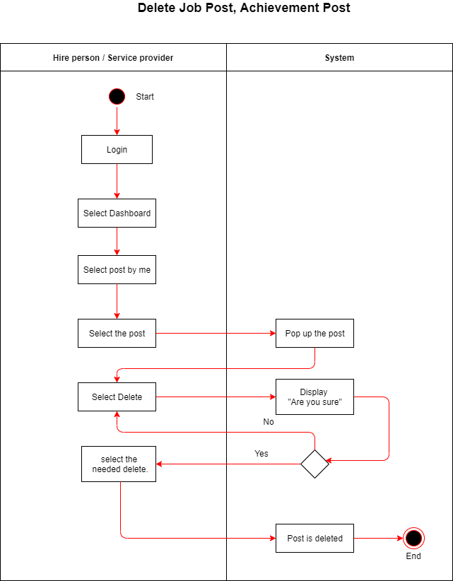

Slide 122
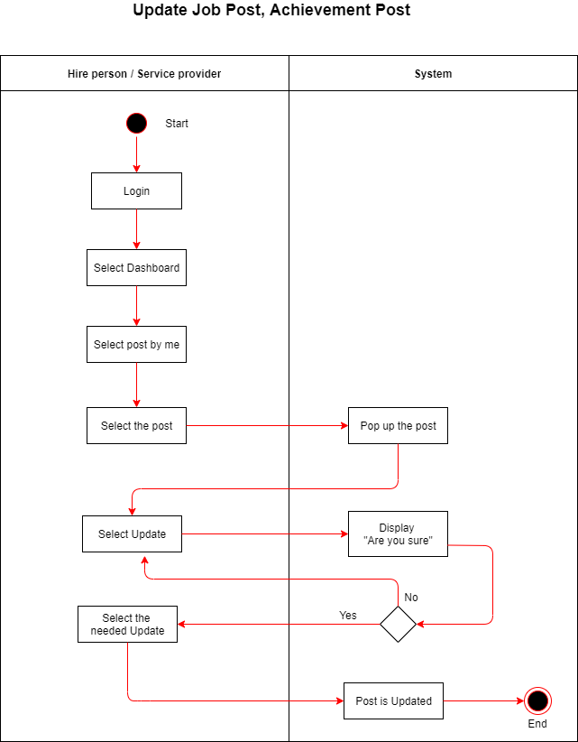

Slide 123
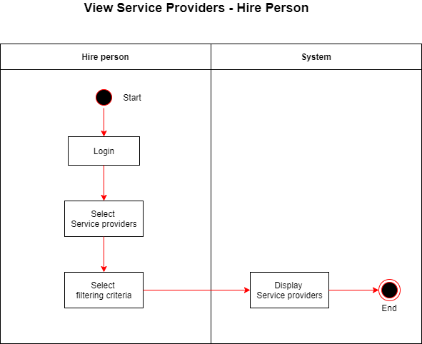

Slide 124
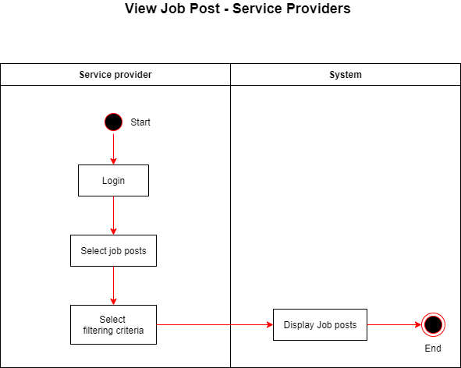

Slide 125
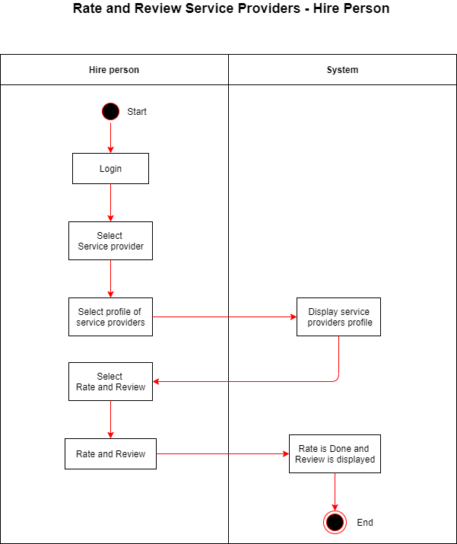

Slide 126
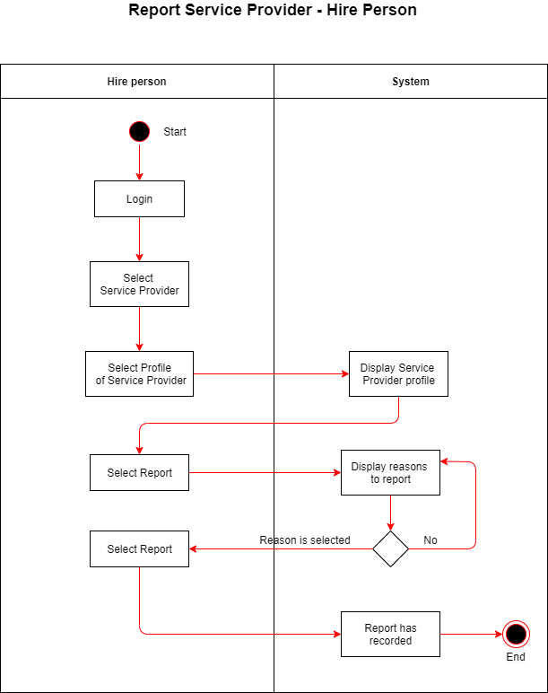

Slide 127
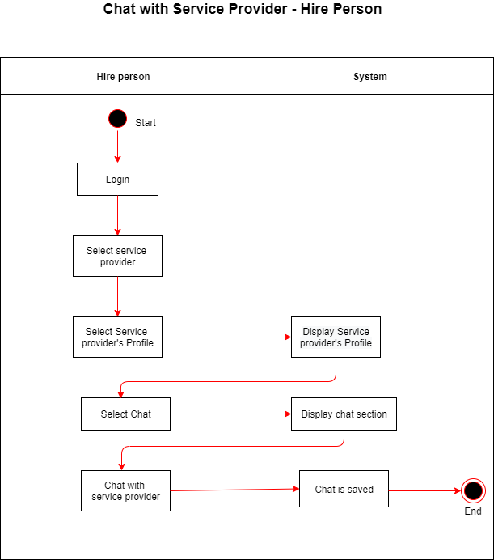

Slide 128
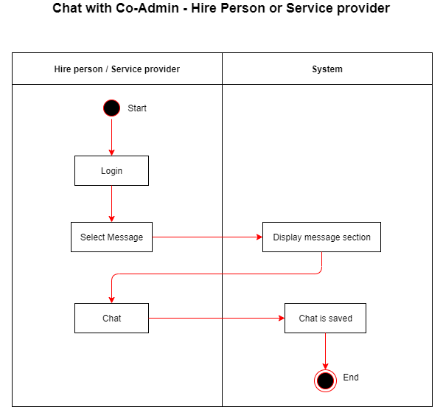

Slide 129


Slide 130


Slide 131


Slide 132


Slide 133


Slide 134


Slide 135


Slide 136


Slide 137


Slide 138


